Slide 1

AI-Text Detection project
Distributed in Big Data Environments
by:AHMED AYESH

Slide 2

Benefits of using Big Data Environment
Scalability
Low-Latency Response
Distributed computing via Apache Spark allows the system to scale horizontally as data volume grows from megabytes to petabytes without re-engineering the pipeline.
Big Data environments support stream processing, enabling real-time detection of AI content on social media feeds and API gateways with sub-second latency.

Slide 3
Introduction of the project
Motivation:
Objectives
The proliferation of AI-generated text ( Llama, Jais) poses challenges for academic integrity, content moderation, and misinformation detection, especially in low-resource languages like Arabic, where NLP tools are less mature. Traditional single-node solutions fail to handle high-volume, high-velocity data streams.
1-Build an end-to-end big data pipeline (batch + streaming).
2-Compare 4 Spark MLlib used models.
3-Simulate real-time inference.
4-Benchmark scalability.

Slide 4
Dataset
Source: Hugging Face – KFUPM-JRCAI/arabic-generated-abstracts (2024).
Size: 41,940 records after flattening.
Splits: by_polishing (2,851), from_title (2,963), from_title_and_content (2,574) – each containing an original human abstract and four LLM-generated versions (Allam, Jais, Llama, OpenAI).
Class Distribution: Perfectly balanced (20% Human, 80% AI across four generators). After preprocessing and deduplication: 36,525 rows.

Slide 5
Preprocessing
• Diacritic removal
• Hamza/alef/yaa/taa-marbuta normalization.
• Stopword removal using NLTK Arabic stopwords
• ISRI light stemming using NLTK.
• Result: tokenized, normalized Arabic text.

Slide 6
Methodology
Distributed Data Pipeline
•Platform: CentOS VM, Spark 4.0.2 local mode , 4GB driver.
•Data Loading: Hugging Face datasets then using Pandas then flatten then save data as a Parquet format,this format reduce the size of data.
•Preprocessing: Spark UDFs for Arabic cleaning (diacritic removal, normalization, stopwords, stemming).
•Storage: Partitioned Parquet by label (data/processed/).

Slide 7
Methodology
Feature Engineering
•f2_letters_ratio = letters / total characters.
•f21_brunet_w =type-token complexity.
•TF-IDF: Tokenizer using HashingTF (10,000 features) then IDF.

Slide 8
Methodology
Spark MLlib Models
•Logistic Regression (maxIter=50, regParam=0.01)
•Random Forest (100 trees, maxDepth=10)
•Linear SVM (maxIter=50)
•Gradient Boosted Trees (maxIter=50, maxDepth=8

Slide 9
Results
Logistic Regression is the best overall (highest accuracy & F1). Random Forest has highest AUC but lower F1 due to bias.
Model | Accuracy | F1-Score | AUC-ROC
Logistic Regression | 0.9538 | 0.9500 | 0.9660
Gradient Boosted Trees | 0.9491 | 0.9431 | 0.9585
Linear SVM | 0.9410 | 0.9428 | 0.9486
Random Forest | 0.9207 | 0.8828 | 0.9682

Slide 10
Stream Processing Implementation
•Simulation: 5 JSON files (batch_000.json … batch_004.json) written to streaming/inbox.
•Structured Streaming: Read Stream then apply same feature UDFs then load saved TF-IDF pipeline & Random Forest model then write Stream to Parquet (append mode, 5 sec trigger).
•Metrics: 50 predictions, live accuracy = 74%.

Slide 11
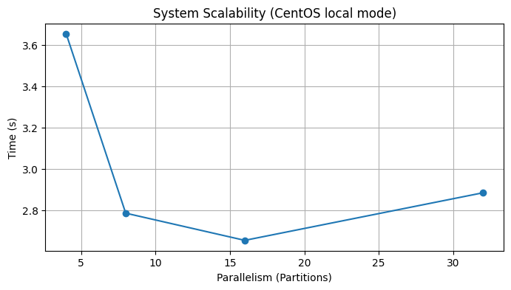
Scalability Benchmark
Partitions | Time (s)
4 | 3.66
8 | 2.79
16 | 2.65
32 | 2.88
Speedup up to 16 partitions (≈28% faster than 4). At 32 partitions, overhead increases. Near-linear scaling in local mode.

Slide 12
Batch vs. Stream Performance
Aspect | Batch (Test) | Stream (Live)
Accuracy | 95.38% (LR) | 74.00% (RF)
Latency | N/A | ~5 sec microbatch
Throughput | 5,476 rows (one pass) | 50 rows (simulated)
Model used | LR (best) | RF (loaded from disk)
Streaming accuracy lower due to smaller sample size and different temporal distribution. In production, use the best batch model (LR) for streaming and increase window size

Slide 13
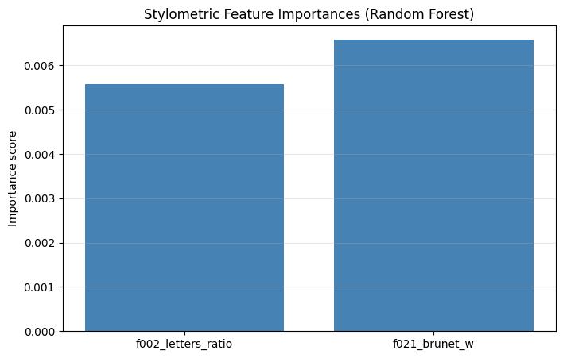
Feature Importance
Feature | Type | Importance Score
f002_letters_ratio | Stylometric | < 0.0001
f021_brunet_w | Stylometric | < 0.0001

Slide 14
Conclusion
Summary:
Spark-based pipeline successfully classifies AI-generated Arabic abstracts with >95% accuracy.
Logistic Regression outperforms tree-based models despite smaller feature space.
Stylometric features contribute little; TF-IDF is the dominant signal.
Structured Streaming enables real-time inference with acceptable accuracy (74% on small sample).
Scalability improves up to 16 partitions on a single VM.

Slide 15
Conclusion
Limitations:
Local mode only – not distributed across a cluster.
Streaming test set is small (50 samples) – not statistically robust.
TF-IDF fixed at 10,000 features may not capture all morphological richness of Arabic.

Slide 16
Conclusion
Future Work:
Deploy on multi-node cluster (AWS EMR, Databricks) with YARN or Kubernetes.
Replace TF-IDF with Arabic BERT embeddings (AraBERT, MARBERT) using Spark NLP.
Use Kappa architecture (pure streaming) with Kafka as source.
Implement online learning (Spark Streaming + mini-batch model updates).
Add more stylometric features (Yule’s K, entropy, POS tagging).

